Slide 1
UNIT-5
What is Concurrency control?
The technique is used to protect data when multiple users are accessing same data concurrently(same time ) is called Concurrency control.
It is the process of managing simultaneous execution of transactions in a shared database to ensure the serializability of transactions.
Purpose of Concurrency control:
To enforce Isolation.(one transaction is not interleaving with another transaction)
To preserve database consistency
To resolve read-write and write-write conflicts.

Slide 2
Concurrency control techniques:
Lock- based protocol
2 phase locking protocol
Time stamp based protocol
Validation based protocol

Slide 3
LOCK-BASED PROTOCOLS
A locking protocol is a set of rules followed by all transactions while requesting and releasing locks.
A lock guarantees exclusive use of a data item to a current transaction.
To access data item(lock acquired)
After completion of transaction(release lock)
A lock is a mechanism to control concurrent access to a data item.
Data items can be locked in two modes:
1. Exclusive (X) mode: Data item can be both read (R) as well as write(W). X-lock is requested using lock-X instruction.
2. Shared (S) mode: Data item can only be read(R) . S-lock is requested using lock-S instruction.
Lock requests are made to concurrency-control manager.
Transaction can proceed only after request is granted.

Slide 4
LOCK-BASED PROTOCOLS
Lock-compatibility matrix:
 | S | X
S | True | False
X | False | False
A transaction may be granted a lock on an item if the requested lock is compatible with locks already held on the item by other transactions.
Any number of transactions can hold shared locks on an item, But if any transaction holds an exclusive on the item no other transaction may hold any lock on the item.

Slide 5
LOCK-BASED PROTOCOLS
If a lock cannot be granted, the requesting transaction is made to wait till all incompatible locks held by other transactions have been released.
The lock is then granted.
Example of a transaction performing locking:
T2: lock-S(A);
read (A);
unlock(A);
lock-S(B);
read (B);
unlock(B);
display(A+B)

Slide 6
Conversion of locks:
Upgrading: from shared to exclusive lock ie R- lock to W-lock
Downgrading : from exclusive to shared lock i.e W-lock to R-lock
Two-phase locking with lock conversions:
First Phase: It can acquire a lock-S on item
can acquire a lock-X on item
can convert a lock-S to a lock-X (upgrade)
Second Phase: It can release a lock-S
can release a lock-X
can convert a lock-X to a lock-S (downgrade)

Slide 7
Two –phase locking protocol(2PL)
This is a protocol which ensures conflict serializable schedules. Requires both locks and unlocks being done in two phases.
Phase 1: Growing (Expanding) Phase: The transaction may obtain locks and transaction may not release locks. i.e New locks on items can be acquired.
Phase 2: Shrinking Phase: The transaction may release locks and transaction may not obtain locks. i.e Existing locks, but no new lock can be acquired.
The point where a transaction acquired its final lock is known as Lock Point.

Slide 8
Variations of 2PL locking protocols
Strict 2PL : Exclusive locks can’t be released till it commits/aborts.
Rigorous 2 PL: Shared /exclusive locks can’t be released till it commits/abort.
Two-phase locking avoids Cascading roll-back.
Deadlock may occur .

Slide 9
Time stamp based protocol
A unique identifier created by DBMS that indicates relative starting time of a transaction. System clock is used at the time of transaction started. Logical counter is incremented after a new time stamp has been assigned.
If an old transaction Ti has timestamp TS (Ti), a new transaction Tj is assigned time-stamp TS (Tj) such that
TS (Ti) < TS (Tj).
Ex: At TS(T1) – 10.00
TS(T2) – 10.30
So, TS(T1)< TS(T2)
Time Stamp values:
R- Read Time stamp(A): is the largest time-stamp of any transaction that executed read (A) successfully.
W-Write Time stamp(A): is the largest time-stamp of any transaction that executed write (A) successfully.

Slide 10
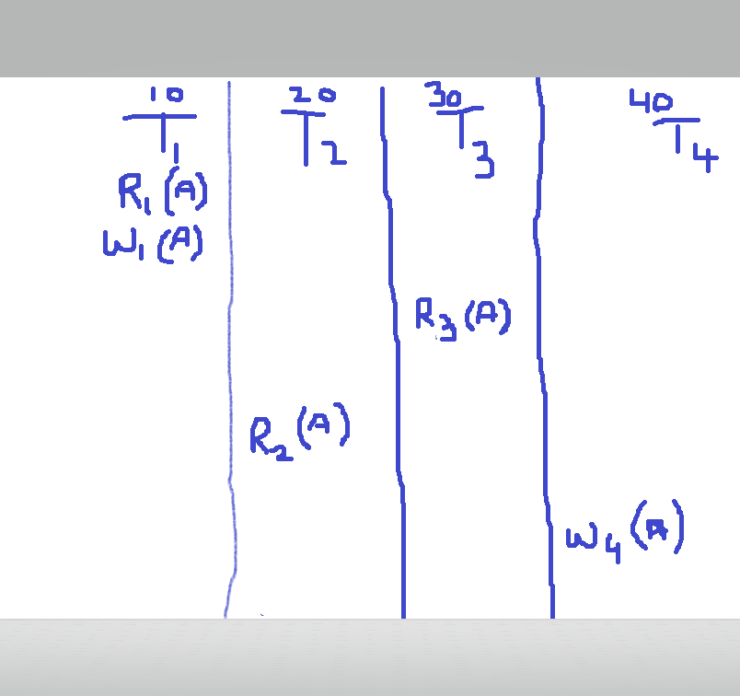
Example of Time stamp based protocol
Let T1=10, T2=20, T3=30, T4 =40
Then Read time stamp is ,
RTS(A) =0
Update T1 =10
0<10 true
Update T3=30
10<30 true
Update T2=20
30<20 is false .
So, RTS (A) =30
Now, for Write Time Stamp is ,
WTS(A) =0 , update T1= 10 ,0<10 true
Update T4 =40 ,10<40 true .So, WTS(A) =40.

Slide 11
Time stamp ordering protocol
The timestamp ordering protocol ensures that any conflicting read and write operations are executed in timestamp order.
Suppose a transaction Ti issues a read(A) :
If TS(Ti)< W(A) Ti is an older transaction then the last transaction that write the value of A(request fails)
2. If TS(Ti) >=W(A) Ti allowed to read update value of A.
Suppose that transaction Ti issues write(A):
If TS(Ti) < R-timestamp(A), then the value of A that Ti is producing was needed previously, and the system assumed that that value would never be produced.
Hence, the write operation is rejected, and Ti is rolled back.
If TS(Ti) < W-timestamp(A), then Ti is attempting to write an obsolete value of Q. Hence, this write operation is rejected, and Ti is rolled back.
Otherwise, the write operation is executed, and W-timestamp(A) is set to TS(Ti).

Slide 12
Validation based protocol
Execution of transaction Ti is done in three phases.
Read and execution phase: Transaction Ti writes only to temporary local variables
Validation phase: Transaction Ti performs a “validation test'' to determine if local variables can be written without violating Serializability.
3) Write phase: If Ti is validated, the updates are applied to database; otherwise, Ti is rolled back. The three phases of concurrently executing transactions can be interleaved, but each transaction must go through the three phases in that order.
Each transaction Ti has 3 timestamps
Start(Ti) : the time when Ti started its execution
Validation(Ti): the time when Ti entered its validation phase
Finish(Ti) : the time when Ti finished its write phase Serializability order is determined by timestamp given at validation time, to increase concurrency.
Thus TS(Ti) is given the value of Validation(Ti).

Slide 13
Thomas’ Write Rule
Modified version of the timestamp-ordering protocol in which obsolete write operations may be ignored under certain circumstances.
When Ti attempts to write data item Q, if TS(Ti) < W-timestamp(Q), then Ti is attempting to write an obsolete value of {Q}.
Rather than rolling back Ti as the timestamp ordering protocol would have done, this {write} operation can be ignored.
Otherwise this protocol is the same as the timestamp ordering protocol.
Thomas' Write Rule allows greater potential concurrency.
Allows some view-serializable schedules that are not conflict-serializable.

Slide 14
MULTIPLE GRANULARITY
Granularity – It is the size of data item allowed to lock. Now Multiple Granularity means hierarchically breaking up the database into blocks which can be locked and can be track what need to lock and in what fashion. Such a hierarchy can be represented graphically as a tree.
Allow data items to be of various sizes and define a hierarchy of data granularities, where the small granularities are nested within larger ones .
Granularity of locking (level in tree where locking is done):
Fine granularity (lower in tree): high concurrency, high locking overhead
coarse granularity (higher in tree): low locking overhead, low concurrency
For example, consider the tree, which consists of four levels of nodes. The highest level represents the entire database. Below it are nodes of type area; the database consists of exactly these areas. Area has children nodes which are called files. Every area has those files that are its child nodes. No file can span more than one area.

Slide 15
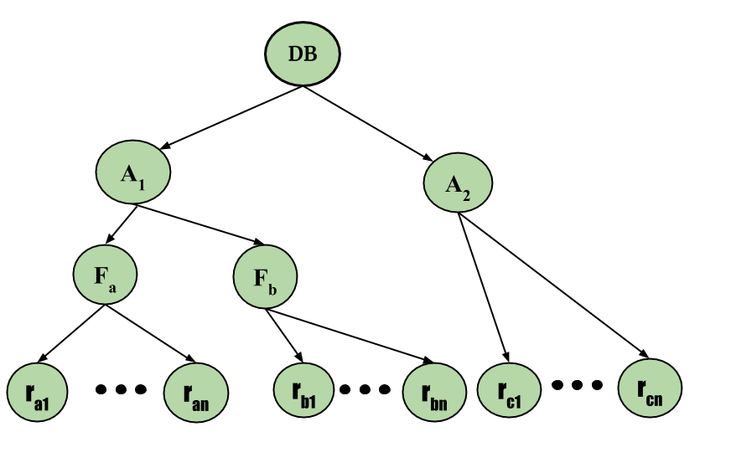
Finally, each file has child nodes called records. As before, the file consists of exactly those records that are its child nodes, and no record can be present in more than one file. Hence, the levels starting from the top level are:
database
area
file
Record

Slide 16
Intention Mode Lock – In addition to S and X lock modes, there are three additional lock modes with multiple granularity:
Intention-Shared (IS): explicit locking at a lower level of the tree but only with shared locks.
Intention-Exclusive (IX): explicit locking at a lower level with exclusive or shared locks.
Shared & Intention-Exclusive (SIX): the sub-tree rooted by that node is locked explicitly in shared mode and explicit locking is being done at a lower level with exclusive mode locks.

Slide 17
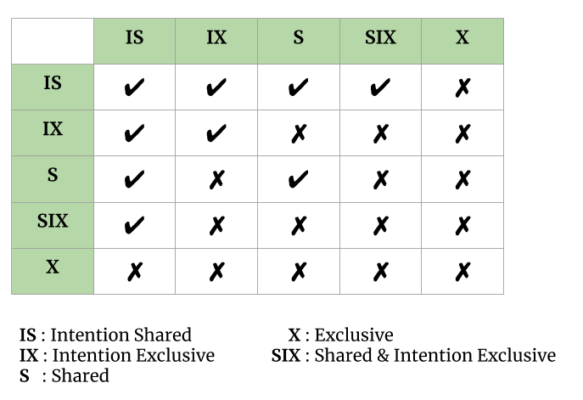
Compatibility Matrix with Intention Lock Modes: The compatibility matrix for all lock modes is:

Slide 18
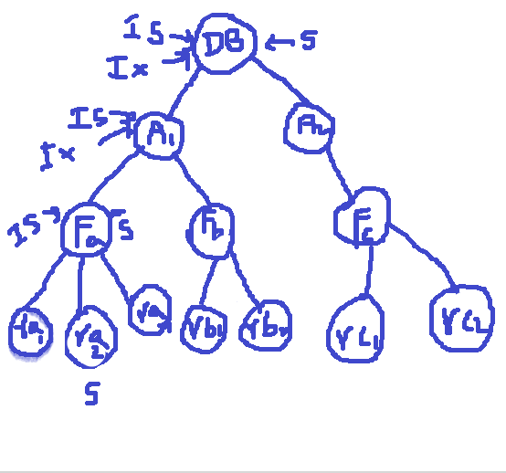
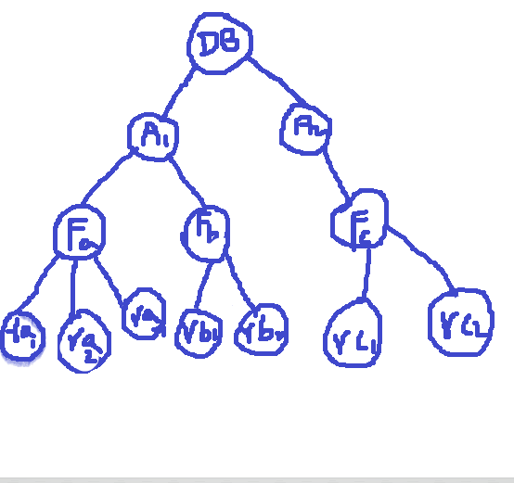
Example :
Say transaction T₁ reads record R_{a2} in file F_{a}. Then, T₂ needs to lock the database, area A₁, and F_{a} in IS mode (and in that order), and finally to lock R_{a2} in S mode.(true)
Say transaction T₂ modifies record R_{a9} in file F_{a} . Then, T₂ needs to lock the database, area A₁, and file F_{a} (and in that order) in IX mode, and at last to lock R_{a9} in X mode.(false)
Say transaction T₃ reads all the records in file F_{a}. Then, T₃ needs to lock the database and area A₁ (and in that order) in IS mode, and at last to lock F_{a} in S mode.(true)
Say transaction T₄ reads the entire database. It can do so after locking the database in S mode.(false)

Slide 19
Multiple Granularity Locking Scheme: Transaction Ti can lock a node Q, using the following rules:
The lock compatibility matrix must be observed.
The root of the tree must be locked first, and may be locked in any mode.
A node Q can be locked by Ti in S or IS mode only if the parent of Q is currently locked by Ti in either IX or IS mode.
A node Q can be locked by Ti in X, SIX, or IX mode only if the parent of Q is currently locked by Ti in either IX or SIX modes.
Ti can lock a node only if it has not previously unlocked any node (that is, Ti is twophase).
Ti can unlock a node Q only if none of the children of Q are currently locked by Ti.
NOTE: Observe that locks are acquired in root-to-leaf order, whereas they are released in leaf to-root order.

Slide 20
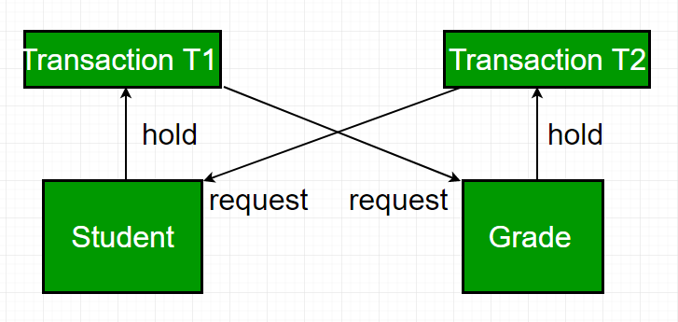
Deadlock Handling
In a database, a deadlock is an unwanted situation in which two or more transactions are waiting indefinitely for one another to release locks.
Example – let us understand the concept of Deadlock with an example : Suppose, Transaction T1 holds a lock on some rows in the Students table and needs to update some rows in the Grades table. Simultaneously, Transaction T2 holds locks on those very rows (Which T1 needs to update) in the Grades table but needs to update the rows in the Student table held by Transaction T1.

Slide 21
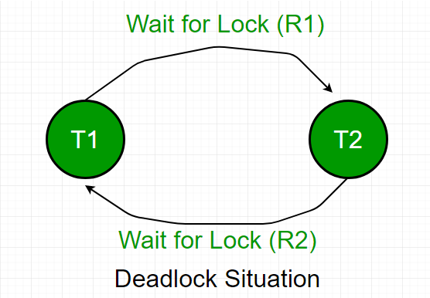
Deadlock Detection: When a transaction waits indefinitely to obtain a lock, The database management system should detect whether the transaction is involved in a deadlock or not. Deadlocks can be described as a wait-for graph.
Wait-for-graph is one of the methods for detecting the deadlock situation. This method is suitable for smaller database. In this method a graph is drawn based on the transaction and their lock on the resource. If the graph created has a closed loop or a cycle, then there is a deadlock. For the above mentioned scenario the Wait-For graph is drawn below:

Slide 22
Deadlocks can be described as a wait-for graph, which consists of a pair G = (V,E).
V is a set of vertices (all the transactions in the system)
E is a set of edges; each element is an ordered pair Ti Tj
If Ti Tj is in E, then there is a directed edge from Ti to Tj, implying that Ti is waiting for Tj to release a data item.
When Ti requests a data item currently being held by Tj, then the edge Ti Tj is inserted in the wait-for graph. This edge is removed only when Tj is no longer holding a data item needed by Ti.
The system is in a deadlock state if and only if the wait-for graph has a cycle.
With cycle
Without cycle

Slide 23
Deadlock prevention
For large database, deadlock prevention method is suitable. A deadlock can be prevented if the resources are allocated in such a way that deadlock never occur. The DBMS analyses the operations whether they can create deadlock situation or not, If they do, that transaction is never allowed to be executed.
Deadlock prevention mechanism proposes two schemes :
1. Wait-Die Scheme: – In this scheme, If a transaction request for a resource that is locked by other transaction, then the DBMS simply checks the timestamp of both transactions and allows the older transaction to wait until the resource is available for execution. Wait-die scheme (non-preemptive): Older transaction may wait for younger one to release data item. Younger transactions never wait for older ones; they are rolled back instead. A transaction may die several times before acquiring needed data item .

Slide 24
2. Wound Wait Scheme – In this scheme, if an older transaction requests for a resource held by younger transaction, then older transaction forces younger transaction to kill the transaction and release the resource. The younger transaction is restarted with minute delay but with same timestamp. If the younger transaction is requesting a resource which is held by older one, then younger transaction is asked to wait till older releases it.
Wound-wait scheme (preemptive) : Older transaction wounds (forces rollback) of younger transaction instead of waiting for it. Younger transactions may wait for older ones. May be fewer rollbacks than wait-die scheme.
Timeout-Based Schemes: A transaction waits for a lock only for a specified amount of time. After that, the wait times out and the transaction is rolled back. Thus deadlocks are not possible.

Slide 25
Deadlock Avoidance – When a database is stuck in a deadlock, It is always better to avoid the deadlock rather than restarting or aborting the database. Deadlock avoidance method is suitable for smaller database whereas deadlock prevention method is suitable for larger database.
Deadlock Recovery: When a deadlock is detected:
Some transaction will have to rolled back (made a victim) to break deadlock.
Select that transaction as victim that will incur minimum cost.
Rollback -- determine how far to roll back transaction
Total rollback: Abort the transaction and then restart it.
More effective to roll back transaction only as far as necessary to break deadlock.
Starvation happens if same transaction is always chosen as victim.
Include the number of rollbacks in the cost factor to avoid starvation.

Slide 26
Recovery System
Failure Classification: Failures are basically classified into three. They are:
1. Transaction Failure:
Logical errors: Transaction cannot complete due to some internal error condition
System errors: The database system must terminate an active transaction due to an error condition (Ex: deadlock)
2. System Crash: A power failure or other hardware or software failure causes the system to crash.
Fail-stop assumption: non-volatile storage contents are assumed to not be corrupted by system crash
Database systems have numerous integrity checks to prevent corruption of disk data
3. Disk Failure: A head crash or similar disk failure destroys all or part of disk storage
Destruction is assumed to be detectable: disk drives use checksums to detect failures

Slide 27
Recovery Algorithms: Recovery algorithms are techniques to ensure database consistency and transaction atomicity and durability despite failures. Recovery algorithms have two parts:
Actions taken during normal transaction processing to ensure enough information exists to recover from failures
Actions taken after a failure to recover the database contents to a state that ensures atomicity, consistency and durability

Slide 28
Failures without loss of data:
This state of the system is reset to that state which existed before the start of the transaction.
Failure with loss of volatile storage:
Active transaction is terminated in an unpredictable manner before it reaches its commit or rollback state and contents of the volatile memory is lost.
Failure with loss of non-volatile storage:
Due to head crash on a disk drive or errors in writing to a non-volatile device .
Failure with loss of stable –storage:
Due to natural and man made disasters recover requires manual re-generation of database. Remedy is storing in multiple copies in physically secured environments in different locations.

Slide 29
Recovery in a centralized DBMS
To implement database transaction in the field of failures using data redundancy may be in the following form:
Logs (records of each transaction like record-id, updated data ,insert,delete)
Check points(all logs which are stored in volatile memory even after crash also can be stored in stable storage)
Archival copies of the database(implementation of stable storage hierarchies)

Slide 30
Logs:
The log, which is usually written to stable storage , contains the redundant data required to recover from
volatile storage failures and also from errors discovered by the transaction or the database system.
For each transaction, the following data is recorded on the log:
A start – of – transaction marked.
The transaction identifier and could include who has initiated and where information is stored.
The record identifier.
The operation’s performed on the records(insert , update ,delete )
The previous values of the modified data.
The update values of the modified records.
A commit transaction marked if the transaction has committed . Otherwise an abort or rollback transaction marked.
The log is written before any problem is made to the database. This is called the “ Write –a head log Strategy”.

Slide 31
Check points:
A check point operation , performed periodically, copies log information from volatile storage to stable storage.
The information and operations performed at each check point consist of the following:
A start of check point along with time and date of the check point is written to the log on a stable storage device.
All log information from the buffers in the volatile storage is copied to the log on the stable storage.
All database updates from the buffers in the volatile storage are propagated to the physical database.(non-volatile storage)
A end of check point record is written and the address of the check-point record is saved on a file accessible to the recovery routine on start-up after a system crash.
The frequency of check point is a design consideration of the recovery system following are the options:
Fixed internal of time(15min)
Transaction- consistent check point ( no new transaction will be allowed)
Action-consistent check point (only after completion of present transaction and no new transactions or new operations will be performed)
Transaction oriented check point( committed transaction will forcefully be allowed to apply check point)

Slide 32
UNDO List: (Ti,Ti+2,Ti+4,Ti+5,Ti+6)
At first all incomplete transactions started before / after Tc are placed in the UNDO list.
After system crash at Tx the recovery system scans backward and will make following lists:
REDO List: (Ti+2,Ti+4,Ti+5) (normal termination but after Tc)
UNDO List: (Ti, Ti+6) (forcefully terminated due to system crash)

Slide 33
Archival database and implementation of the storage hierarchy
Physical database : It is the online copy of t he database that is stored in non-volatile storage.
Current database is the current version of the database is made up of the physical database plus modifications implied by buffer in volatile storage.
Archival database in the stable storage is the copy of database in the stable storage in the quiescent mode.
Current log contains the log information(including the check point) required for recovery from system failure involving loss of volatile information.
Archival log is used for failures involving loss of non-volatile information on all transactions made on the database from the time of archives copy in the chronological order.
The materialized database is that portion of the database that will intact after failure. The intent is to limit the amount of lost data and loss of completed transactions.

Slide 34
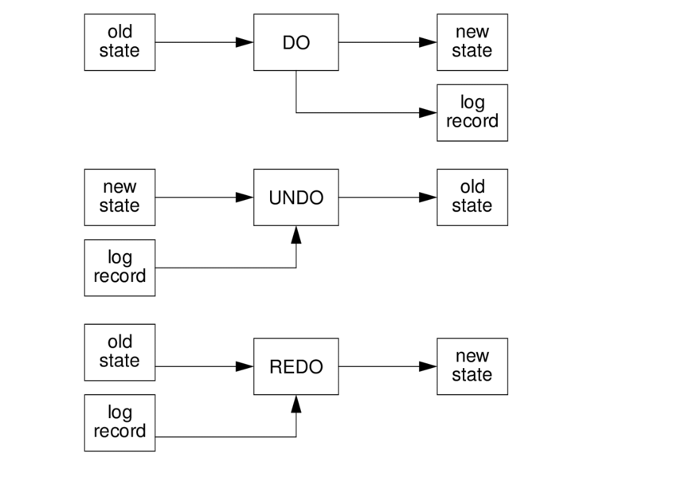

Slide 35
ARIES stands for “Algorithm for Recovery and Isolation Exploiting Semantics.”
No force type of back up approach
Recovery manager is called at time of crash
3 steps of phases in ARIES--- analysis, redo, undo
ARIES Recovery Algorithm: ARIES recovery involves three passes
Analysis Pass: Determines
Which transactions to undo
Which pages were dirty (disk version not up to date) at time of crash
RedoLSN: LSN from which redo should start
2. Redo Pass: Repeats history, redoing all actions from RedoLSN
RecLSN and PageLSNs are used to avoid redoing actions already reflected on page
3. Undo Pass: Rolls back all incomplete transactions. Transactions whose abort was complete earlier are not undone
Key idea: no need to undo these transactions: earlier undo actions were logged, and are redone as required

Slide 36
Advantages of ARIES
Simple and Flexible
Support concurrency control protocols.
Independent recovery of every pages.
Transactions records save points and roll back up to that save point.

